Slide 1
2021 CODE CHANGE OPEN HOUSE
Kathy Grove Associate Building Official
May 2024

Slide 2
Now Using:
2021 VUSBC
Adopted Jan 18, 2024
Building Code is updated every 3 years
State property must use new code immediately, all others have 1 year grace period
For UVA projects, if the Preliminary Design review was complete after adoption date you must use 2021 VUSBC

Slide 3
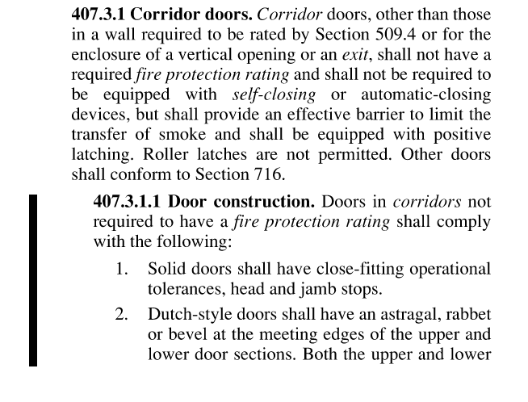
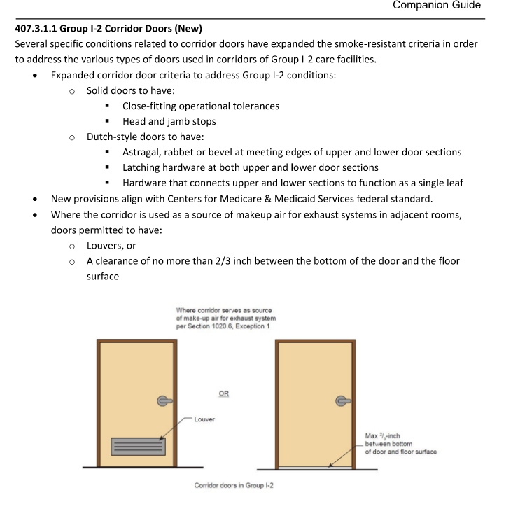
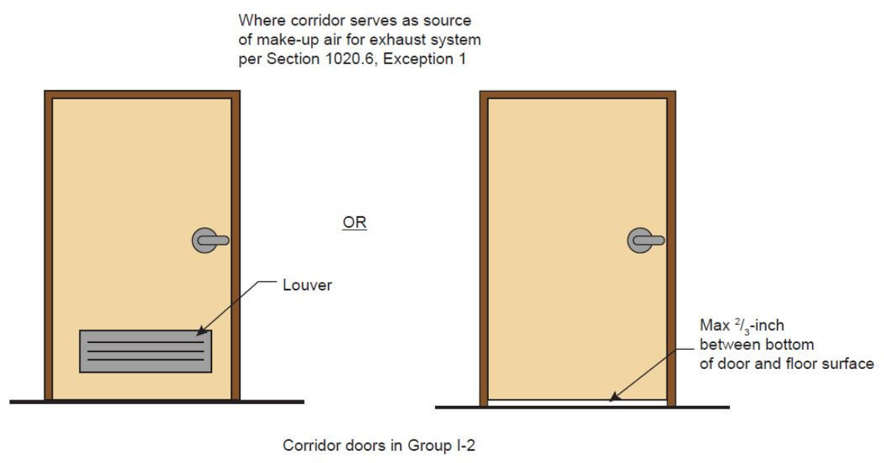
407 I-2 Corridor Doors
407.3.1.1 Added door construction clarifications when no fire rating is required
Door construction to have close-fitting operational tolerances
Head and jamb stops
Additional info if corridor is used for makeup air
Aligns VCC with JHACO (CMS) standards

Slide 4
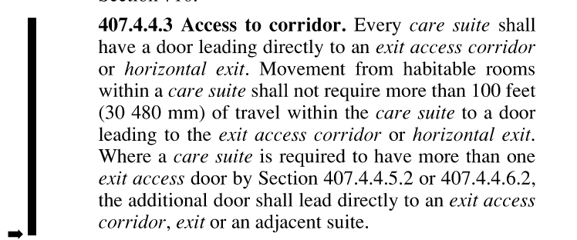
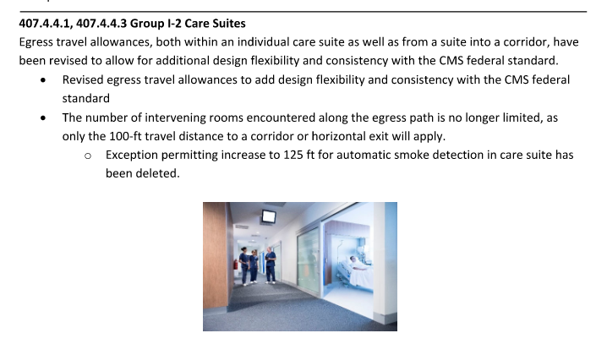
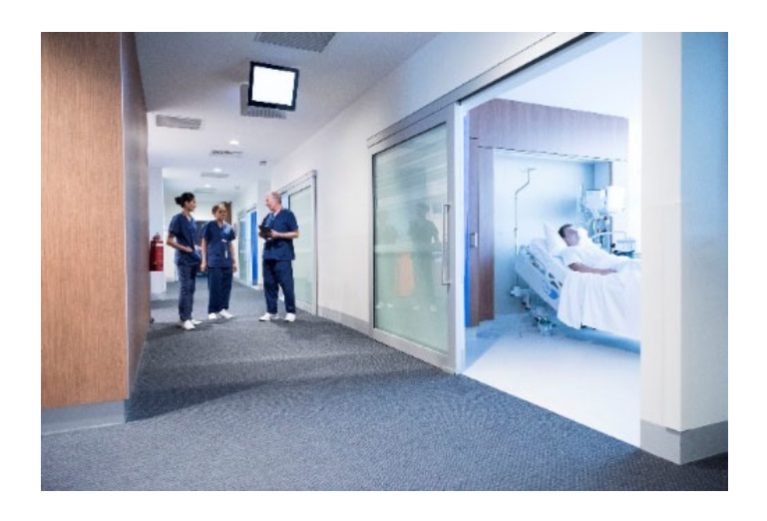
407 I-2 Care Suites
407.4.4.3 Provided more flexibility for care suite access
Removed limit on intervening rooms
Requires only 100ft travel distance
Provides consistency with JHACO (CMS) standards

Slide 5
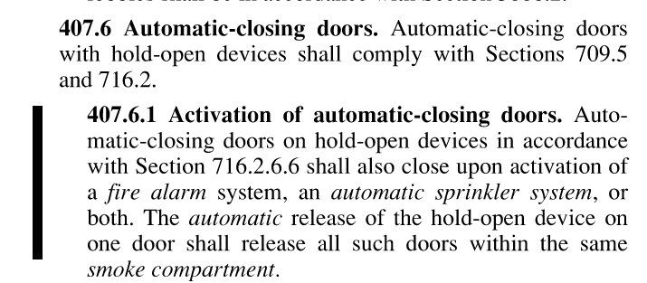
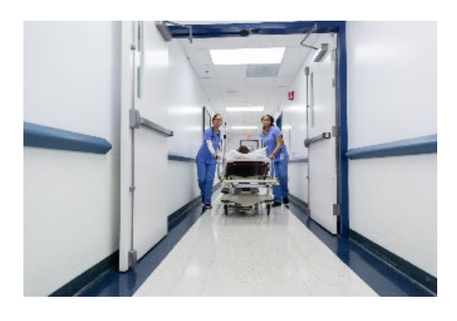
407 I-2 Auto-Close Doors
407.6.1 Close upon activation of fire alarm and/or sprinkler
(in addition to smoke detection per 716.2.6.6)
Previously was activated upon smoke detection only (716.2.6.6)
If one door drops in a compartment, all doors of that compartment drop
Applies to required auto-closing doors and design decision hold open doors
Provides consistency with JHACO (CMS) standards

Slide 6
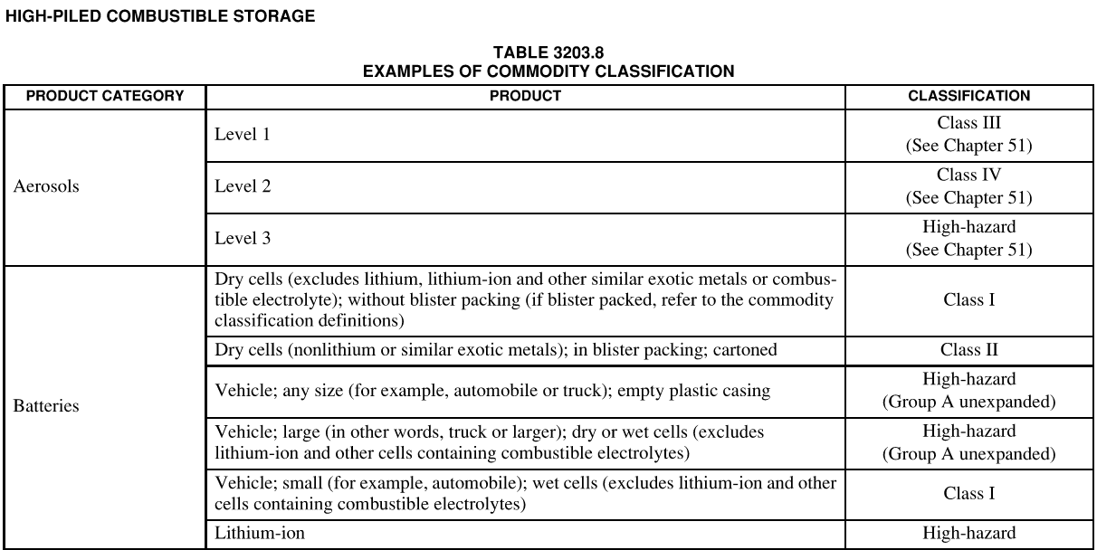
413 Lithium Batteries
Change is actually to Table 3203.8 of IFC
- High piled storage of lithium-ion batteries now considered a high-hazard occupancy

Slide 7
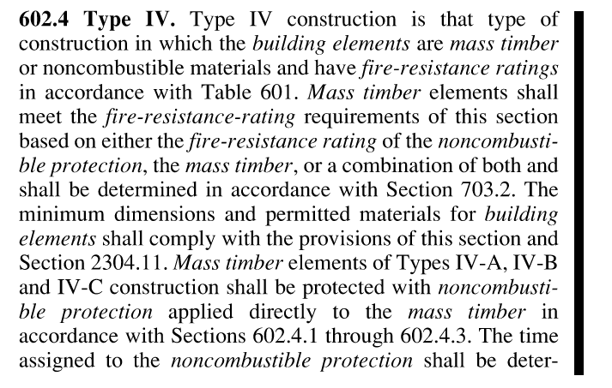
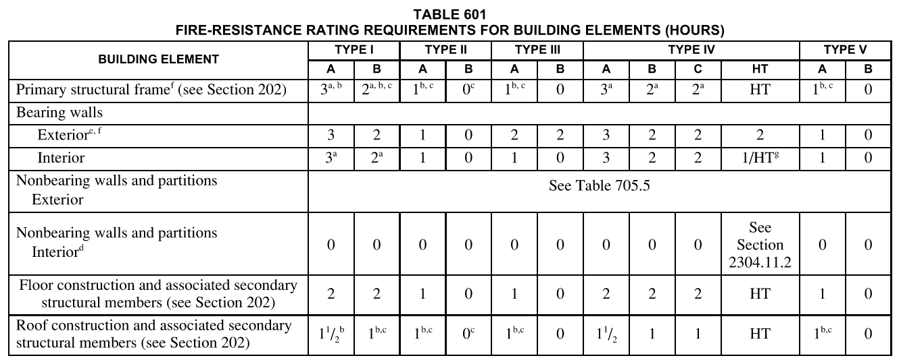
601 Type IV Construction
Mass timber building elements or non-combustible material have fire resistance ratings
See table 601
Ratings determined per 703.2
Dimensions and materials per 2304.11
See also 602.4.1 for additional protection requirements applied to mass timber

Slide 8
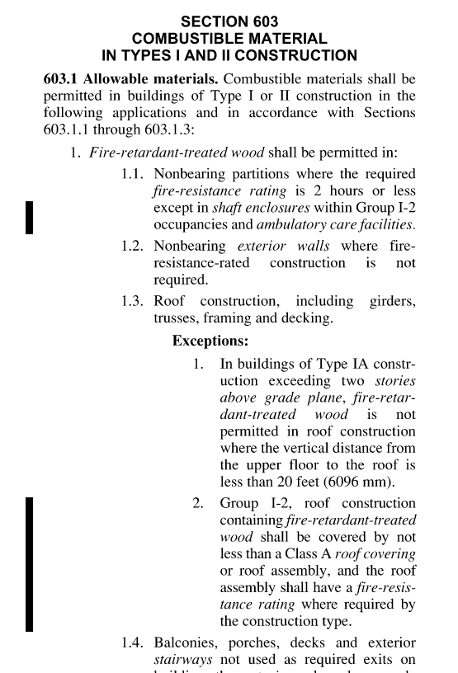
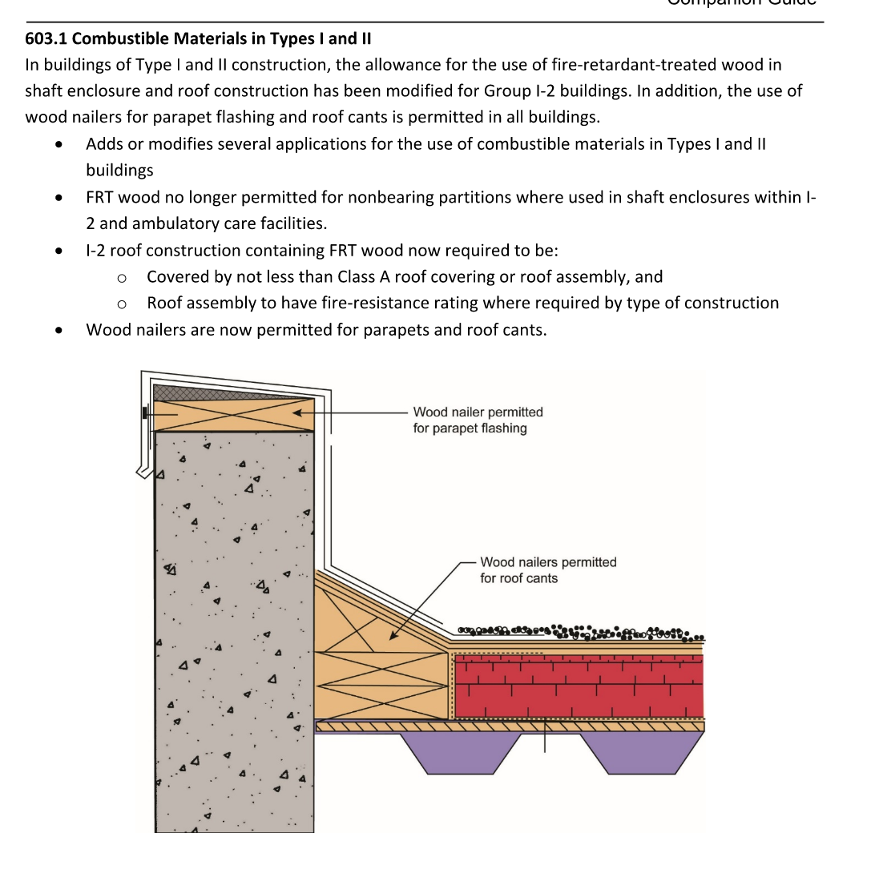
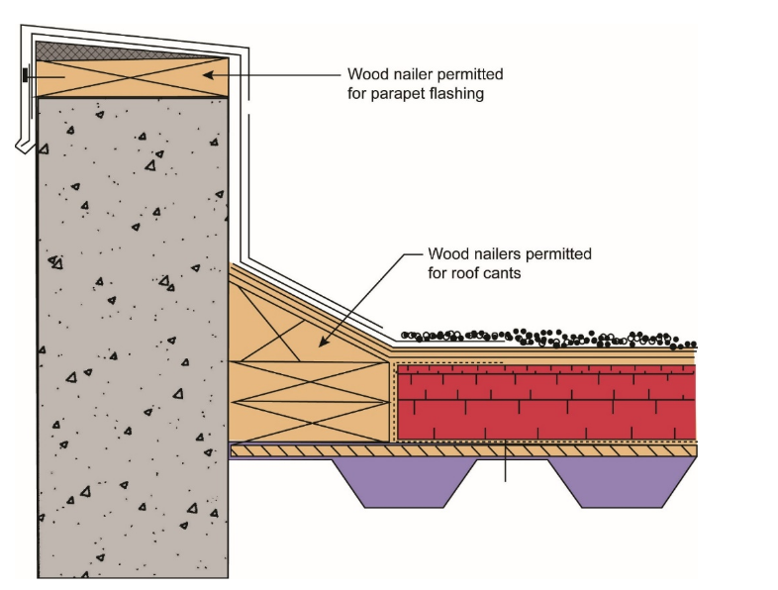
603 Combustible Material
Allows the use of FRT wood and wood nailers in previously prohibited locations
I2 Type I and Type II
Allow FRT in shaft enclosure
Allow FRT in roof construction
Parapet flashing and roof cants
Allow wood nailers in all buildings

Slide 9
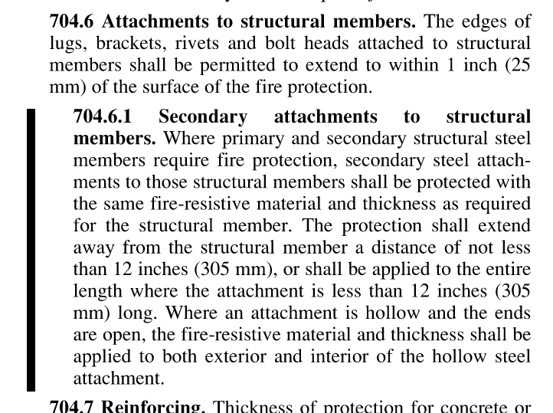
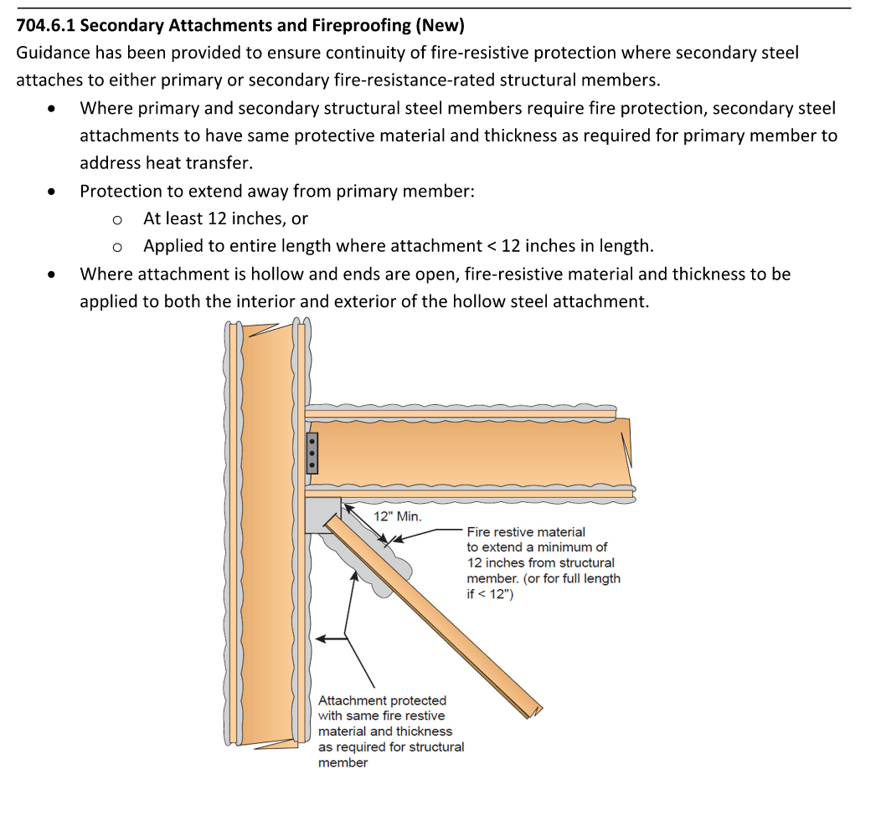
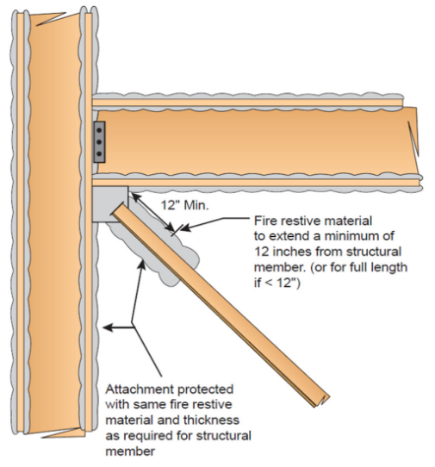
704 SFRM
704.6.1 Provides direction for coverage of secondary steel members attaching to primary steel members
Extend 12 inches from primary member or entire length, whichever is longer
If secondary steel is hollow, SFRM applied to both interior and exterior of secondary attachment

Slide 10
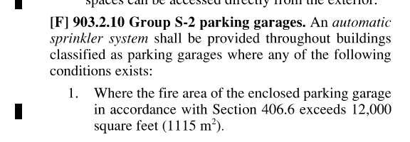
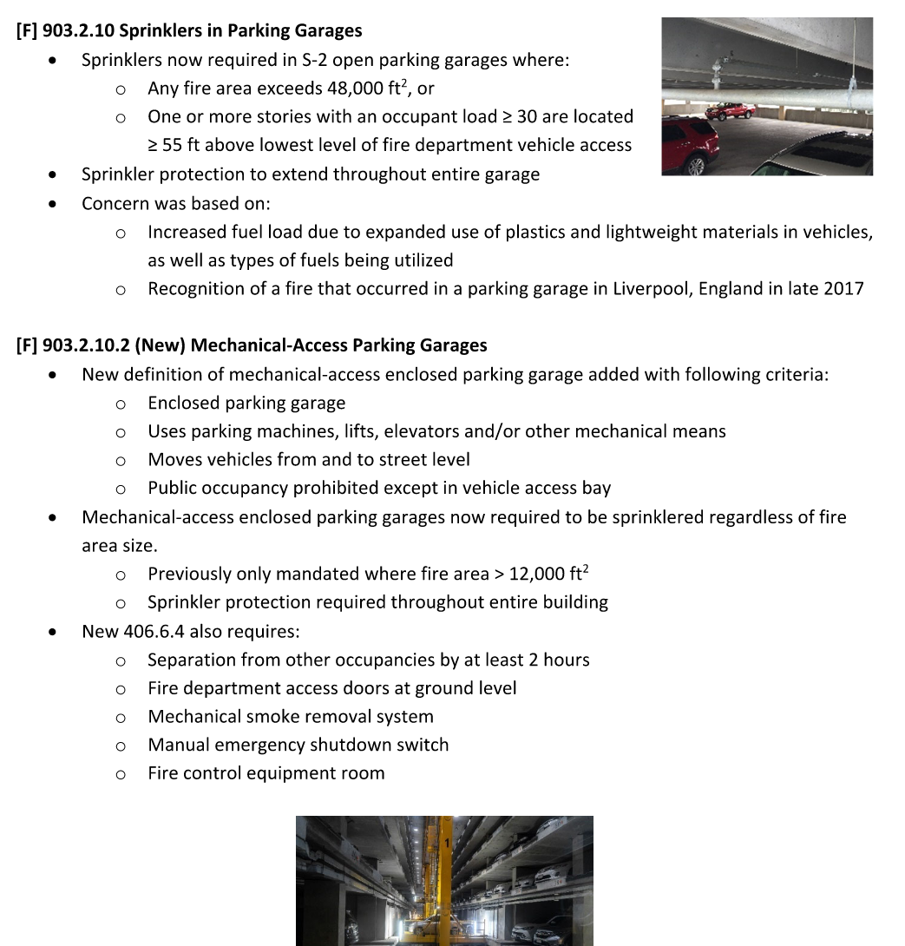
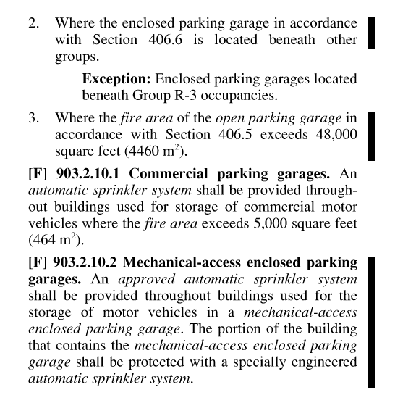
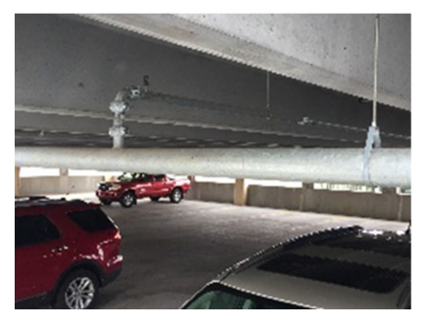
903 Garages & Sprinklers
903.2.10 Now requires sprinklers in S-2 open parking garages
Sprinkler protection throughout entire garage
Concern was based on
Increased fuel load from plastics and lightweight materials
Vehicle fuels used
Response to fire in parking garage in Liverpool England 2017

Slide 11
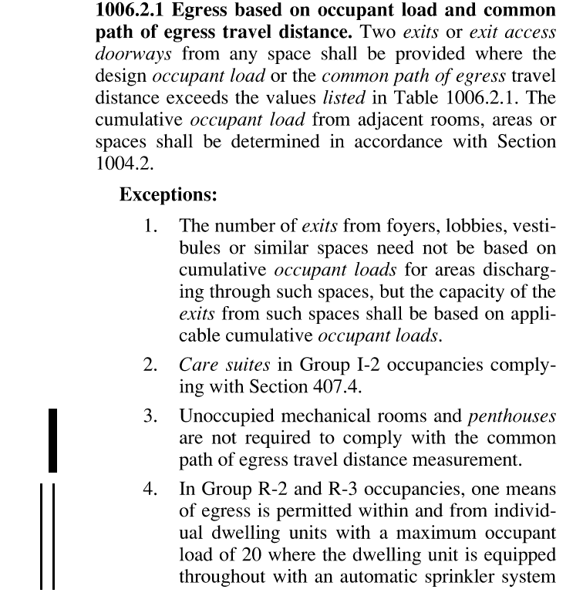
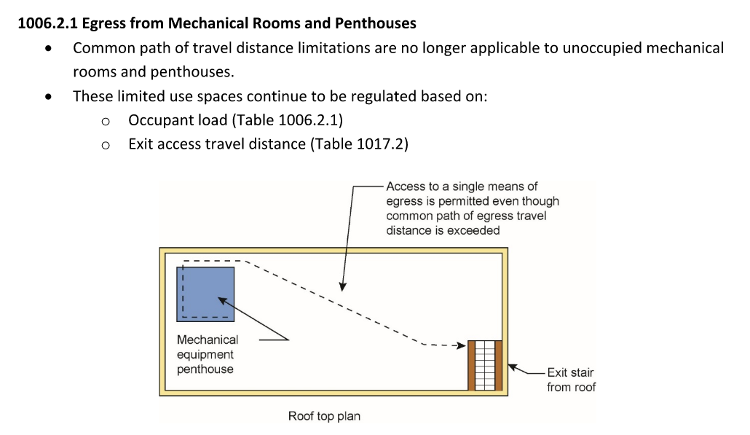
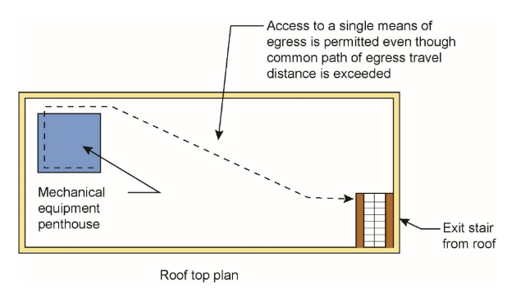
1006 Egress
1006.2.1 Changes for travel distance of unoccupied mechanical rooms and penthouses
Common path of travel distance limits no longer applicable
Regulated based on occupant load and exit access travel distance

Slide 12
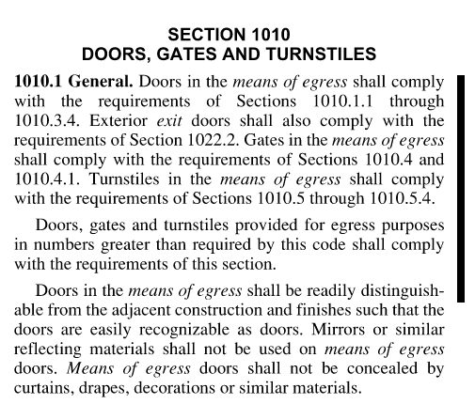
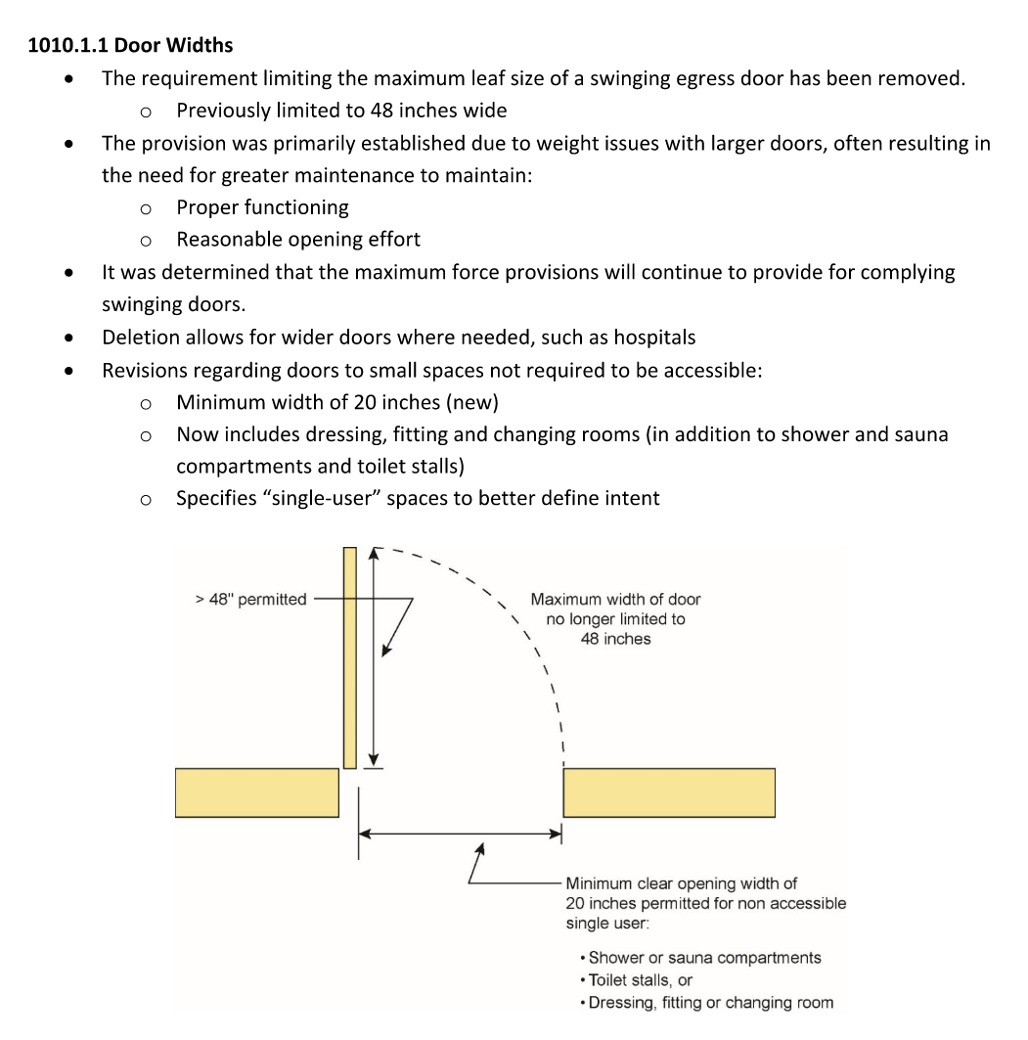
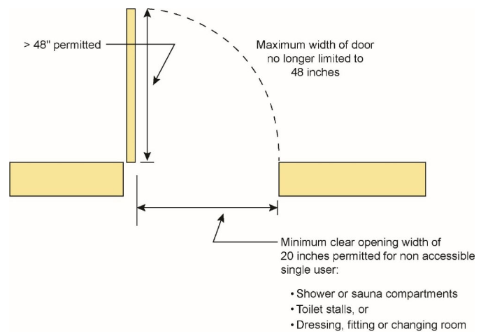
1010 Door Widths
1010.1.1 Changes to required door widths at different locations
Removed 48 in max leaf size for swinging door
Set minimum width of 20 inches for non-accessible single user spaces
Must still comply with opening force requirements

Slide 13
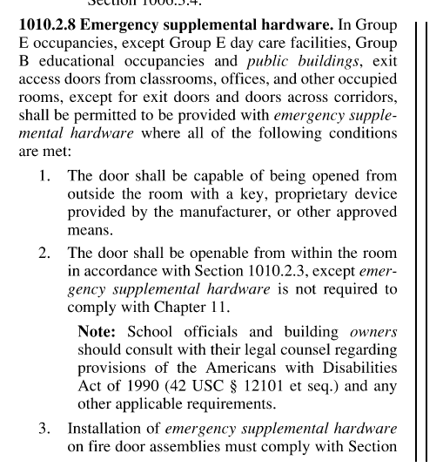
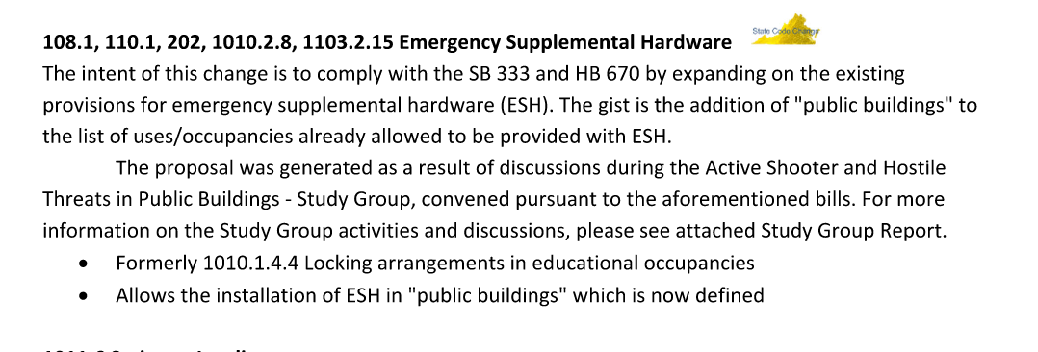
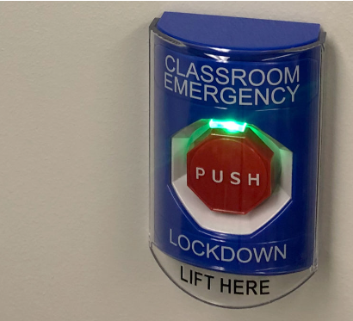
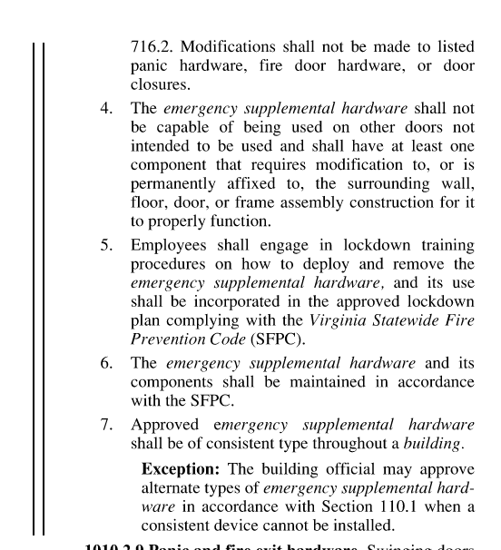
1010 Emergency Supplemental Hardware
1010.2.8 “Lockdown Buttons” in classrooms
Installation or Removal requires building permit
Requires ‘lockdown plan’ and ‘authorized personnel training’ – UVA is working out what this will be
New installations should not be placed in service until plan and training protocols are in place

Slide 14
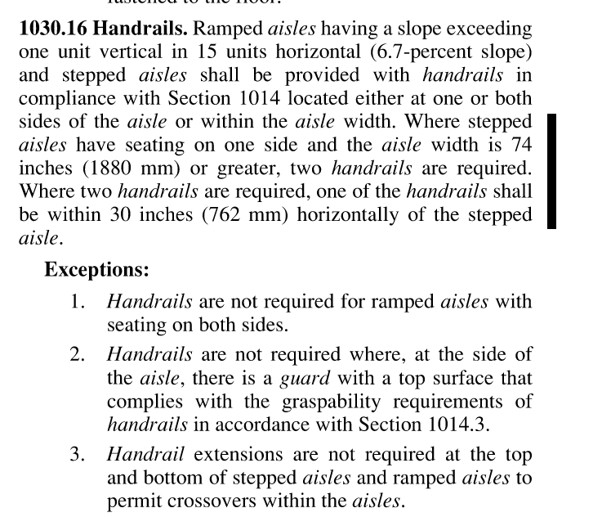
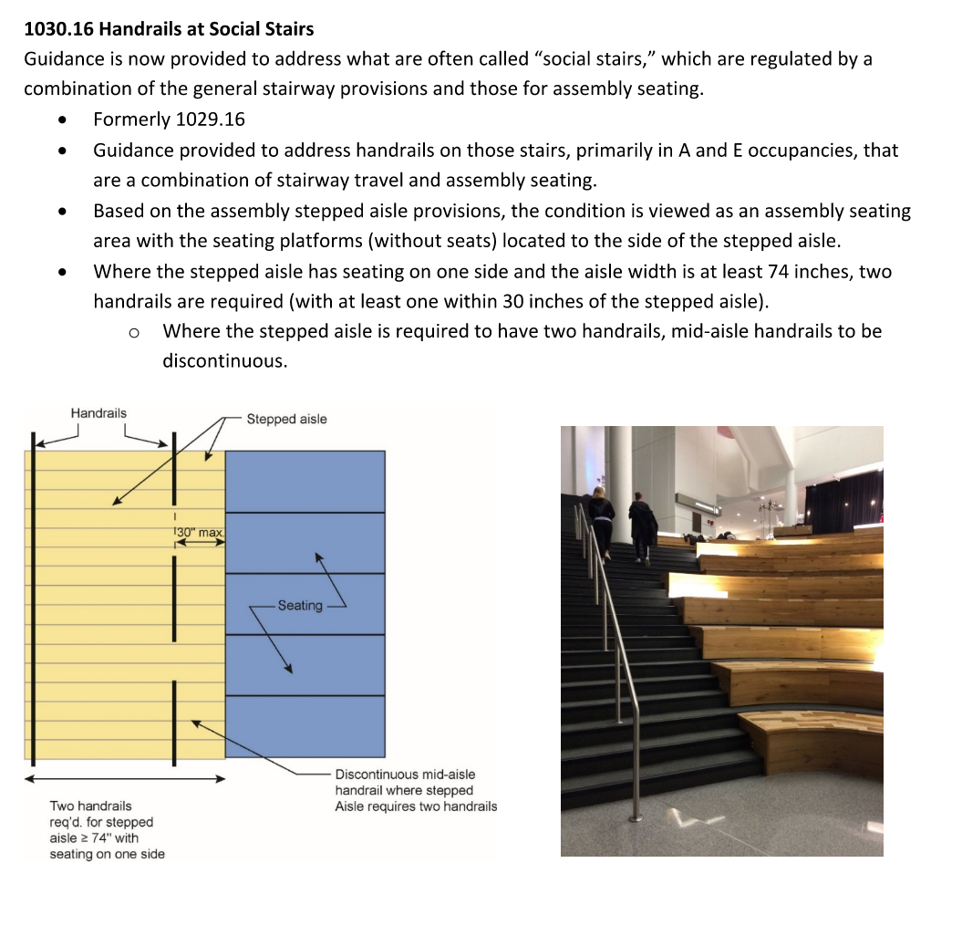
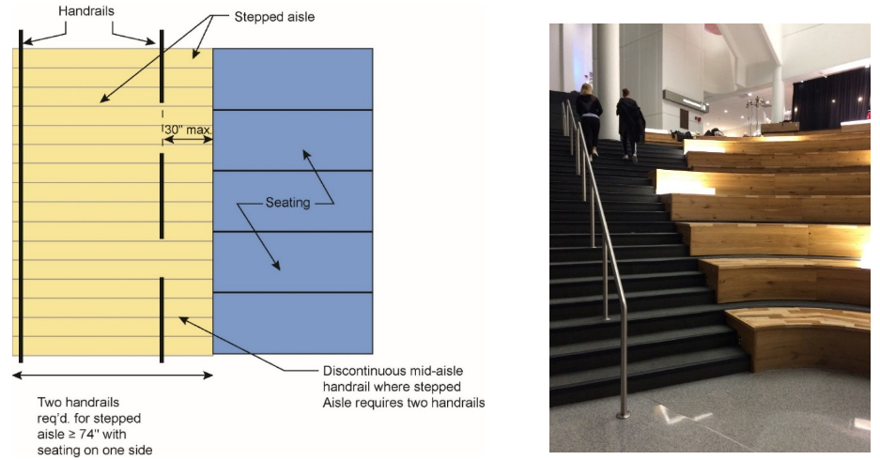
1030 Handrails at Assembly Spaces
1030.16 Handrails at “Social Stairs”
Stepped aisles of 74 inches or greater require two handrails
One within 30 inches horizontally of the seating

Slide 15
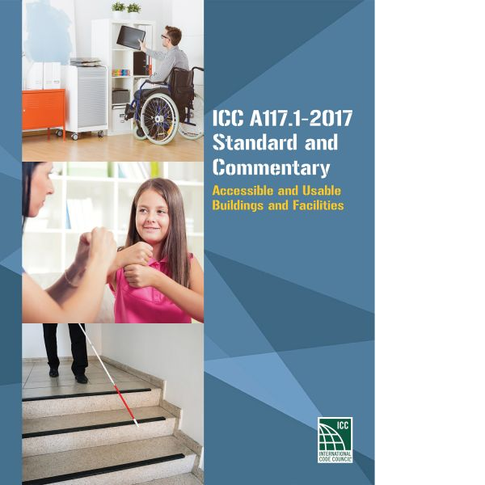
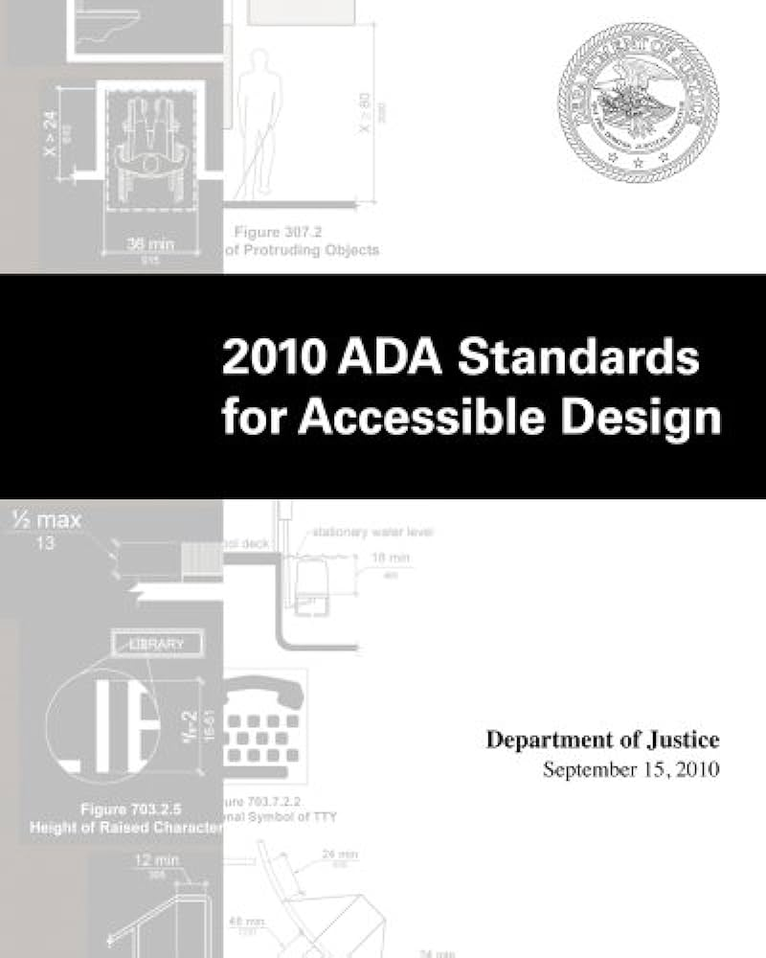
1102 ANSI
Move from ADA 2010 to ICC A117.1 Standard
Updates A117.1 from 2009 to 2017
Largely identical requirements between ADA and A117.1
Exceptions for NEW BUILDINGS
Larger clear floor space
Larger turning requirements
Larger toilet stalls, etc
Fit image here

Slide 16
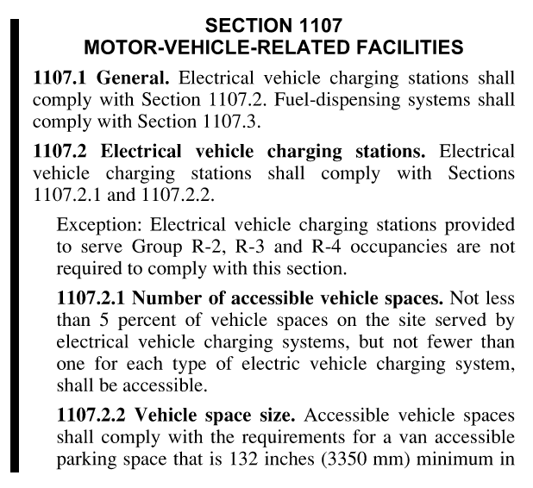
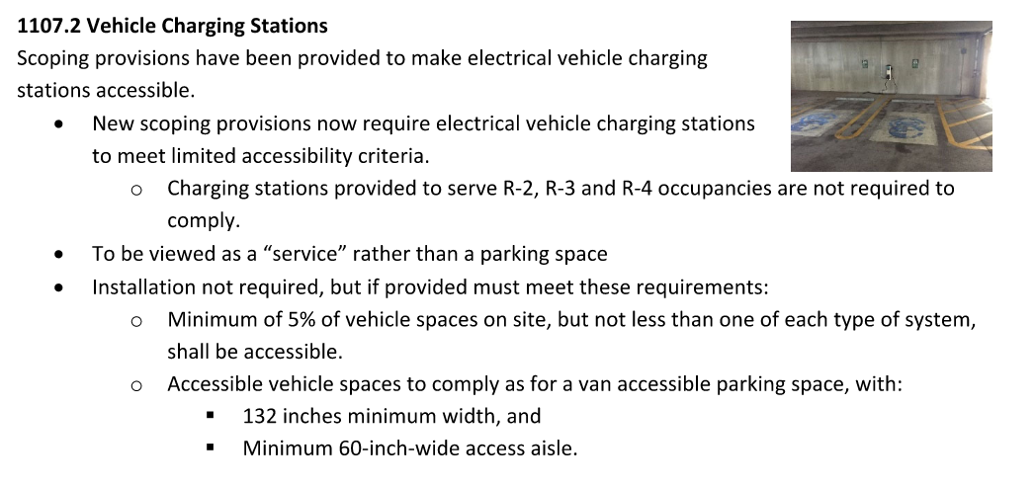
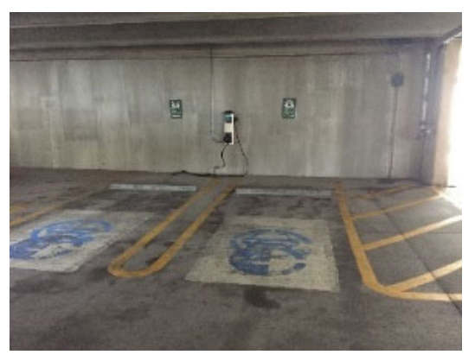
1107 Vehicle Charging
1107.2 Accessibility criteria at EV charging stations
Install not required
If provided, must be minimum 5% but not less than 1 of each type of system
Accessible vehicle spaces must meet van accessible parking space dimensions

Slide 17
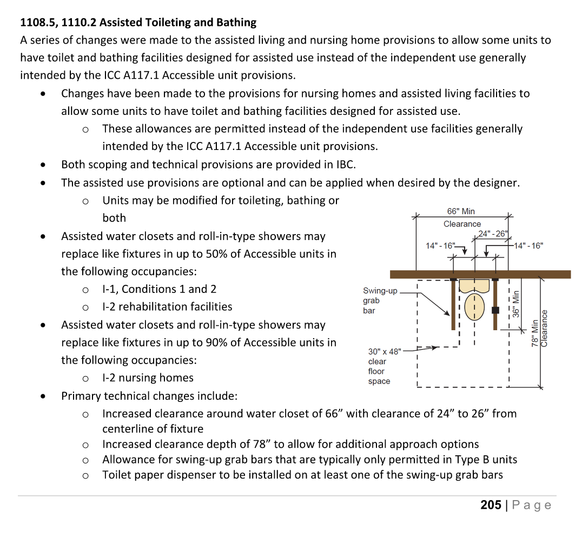
1108 Assisted Toileting
1108.5 and 1110.2 Provisions are optional?
??
Fit image here

Slide 18
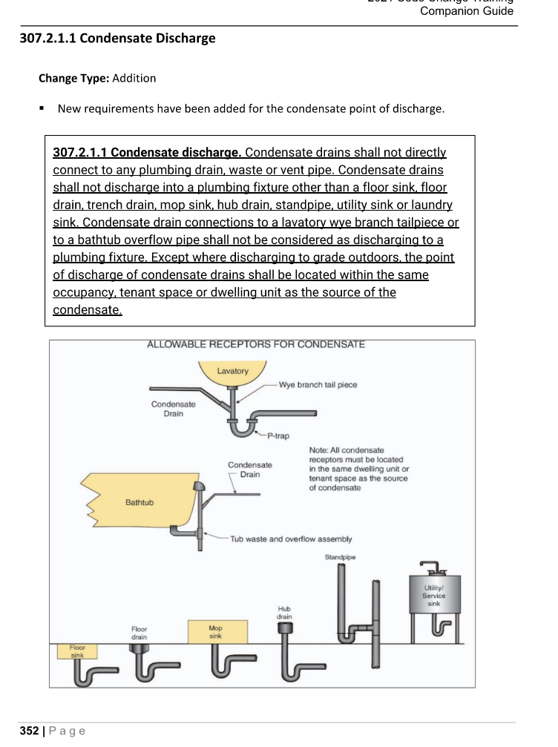
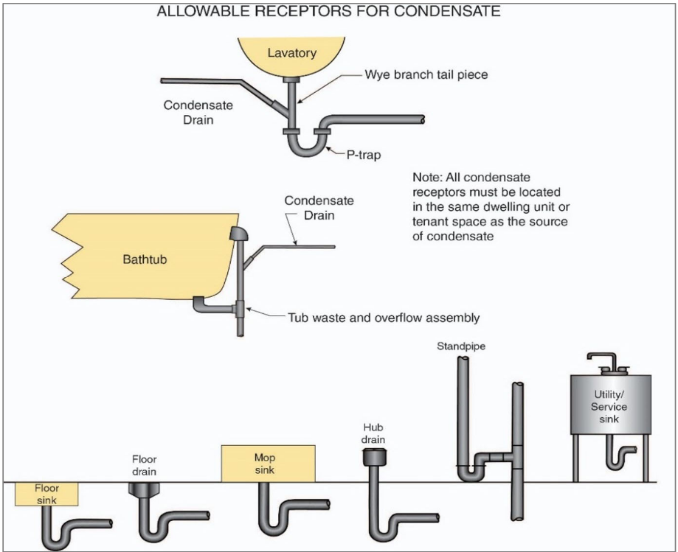
VMC 307 Condensate
307.2.1.1 New requirements for condensate point of discharge
Shall not directly connect to any plumbing drain, waste, or vent pipe
Lists out only allowable receptors

Slide 19
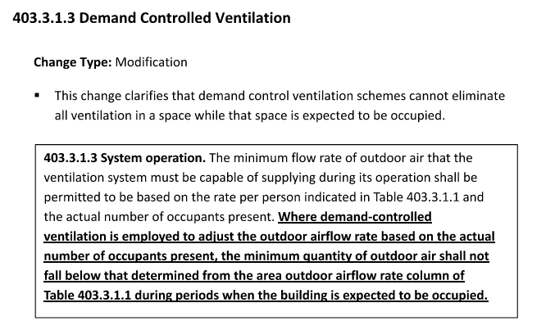
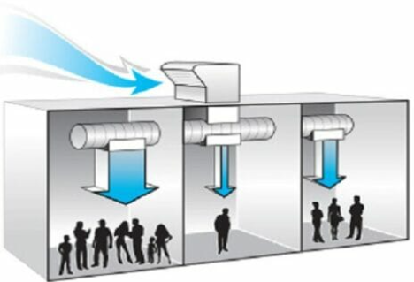
VMC 403 Demand Controlled Ventilation
403.3.1.3 Clarification provided
Demand control ventilation cannot eliminate all ventilation while the space is expected to be occupied

Slide 20
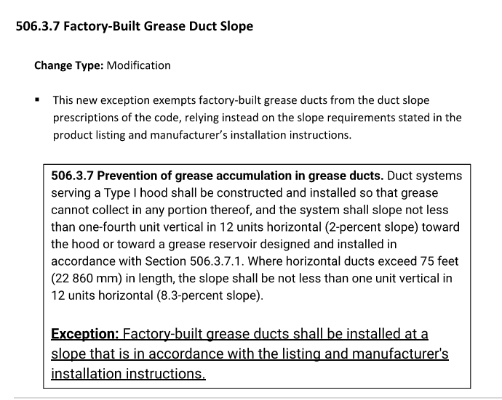
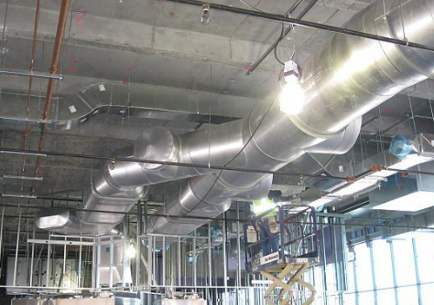
VMC 506 Grease Duct
506.3.7 Modification to slope of factory built grease duct
Factory-built grease ducts exempt from duct slope code requirements
Rely on manufacturer install instructions instead

Slide 21
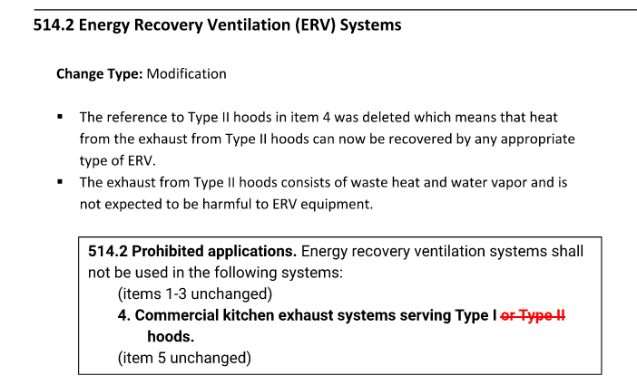
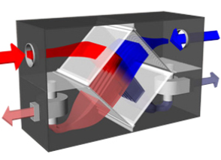
VMC 514 ERV System
514.2 Modification to Energy Recovery Ventilation Systems
The exhaust from Type II hoods can now be recovered by any appropriate type of ERV

Slide 22
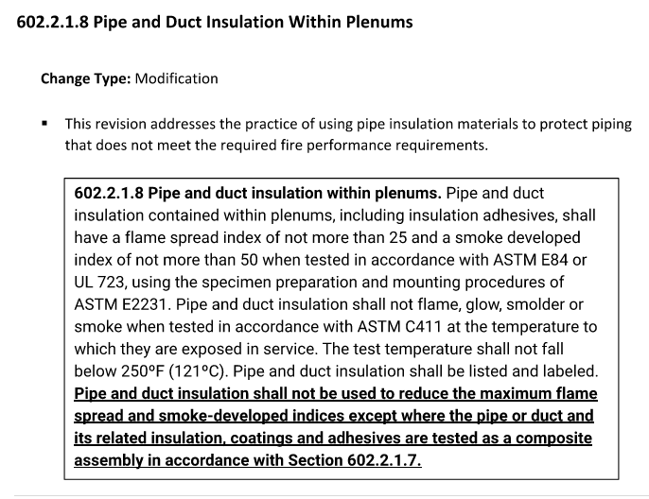
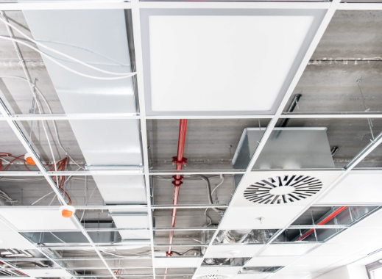
VMC 602 Insulation in Plenums
602.2.1.8 Pipe and Duct Insulation Within Plenums
Addresses the practice of using insulation materials to protect piping that does not meet the required fire performance requirements

Slide 23
NEC 230 Service Disconnect
230.71 (A)
The six allowed service disconnects at a service cannot be in the same enclosure.

Slide 24
NEC 408
408.6 Short circuit rating for switchboards and switchgear
Available fault current and the date it was calculated must be marked on the enclosure at the point of supply

Slide 25
NEC 422
422.5 GFCI required on appliances
Added bottle-fill stations, sump pumps, and dishwashers to this section

Slide 26
QUESTIONS?
Additional Training Resources:
Full manual will be posted to OUBO website in coming days
Virginia AIA Code Change event https://www.aiava.org/events/category/education_events/?post_type=sp_events&eventDisplay=upcoming
DHCD https://www.dhcd.virginia.gov/code-change-training

Slide 27
THANK YOU

Slide 28
CODE SECTION TITLE
More details and what it is
Any bullet points
Fit image here

